Slide 1
DISTINGUISHING POISONOUS FROM EDIBLE MUSHROOMS
REKHA. J

Slide 2
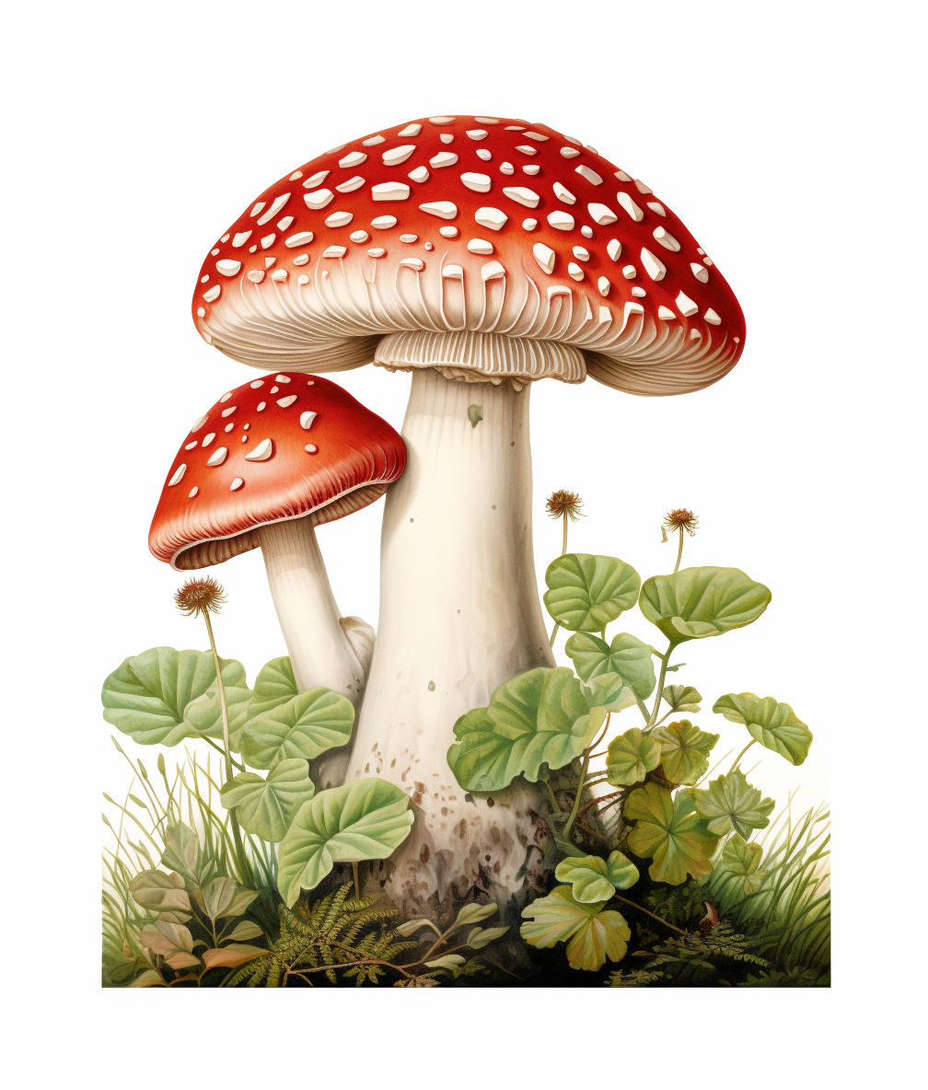
The objective of this project is to develop a robust and accurate machine learning model capable of predicting the edibility status of mushrooms, discerning between poisonous and edible varieties, leveraging a comprehensive set of features that encapsulate various attributes such as cap shape, cap surface, gill characteristics, stem dimensions, veil properties, and spore print color. Through extensive analysis and predictive modeling, the goal is to create a reliable tool for differentiating between mushroom types, ensuring the safety of individuals engaging in mushroom foraging or related activities.
OBJECTIVE

Slide 3
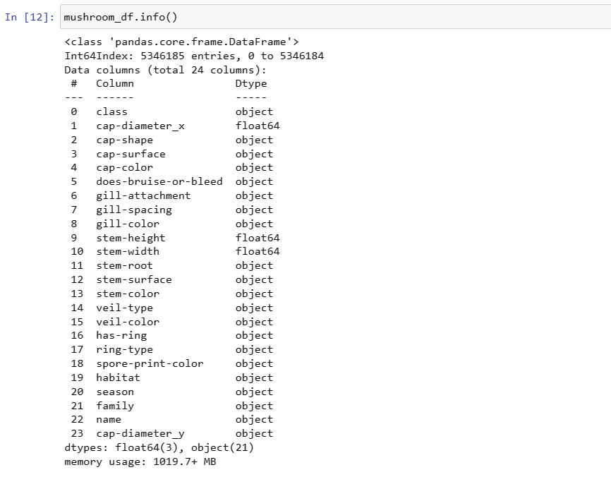
DATASET INFORMATION

Slide 4
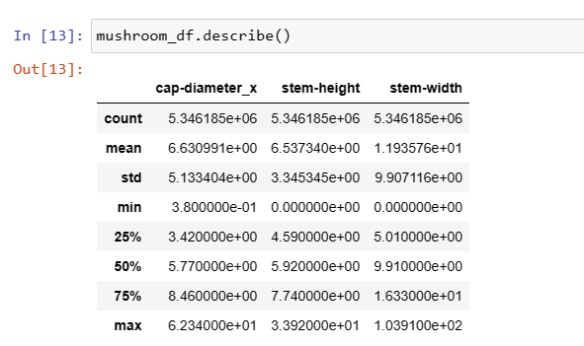
DESCRIPTIVE DETAILS

Slide 5
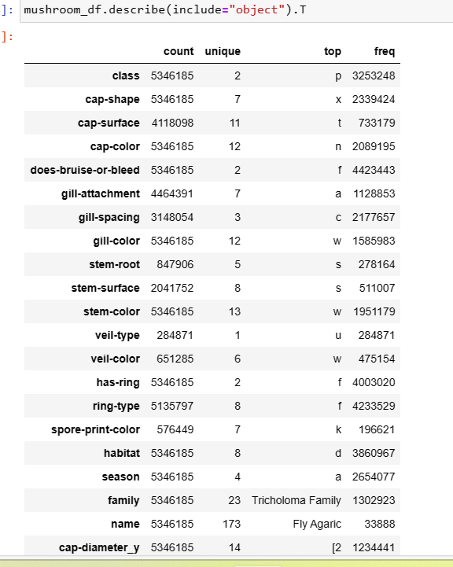
DESCRIPTIVE DETAILS

Slide 6
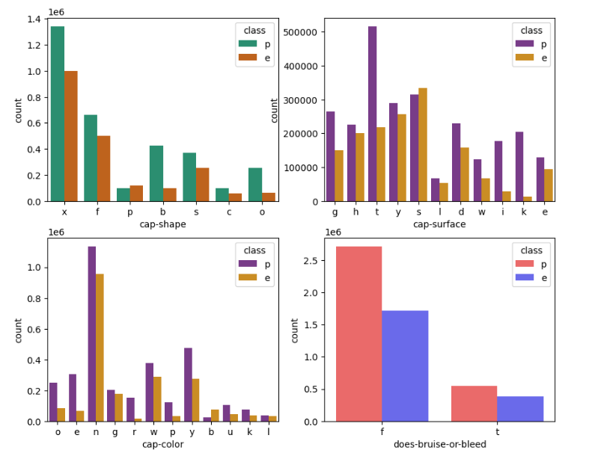
BIVARIATE ANALYSIS
The Convex Cap Shape is the most frequent. following types which are Bell and other, the class types are pretty imbalanced distributed might be completely poisons mushrooms.
Where the classes like, sticky,fibrous,silky,grooves surfaced mushroom are poisonous
Most frequent mushrooms are brown colored one, more poisonous mushrooms are red colored, buff cap colored mushroom are highly edible
Where in no bruises might be poisonous mushroom

Slide 7
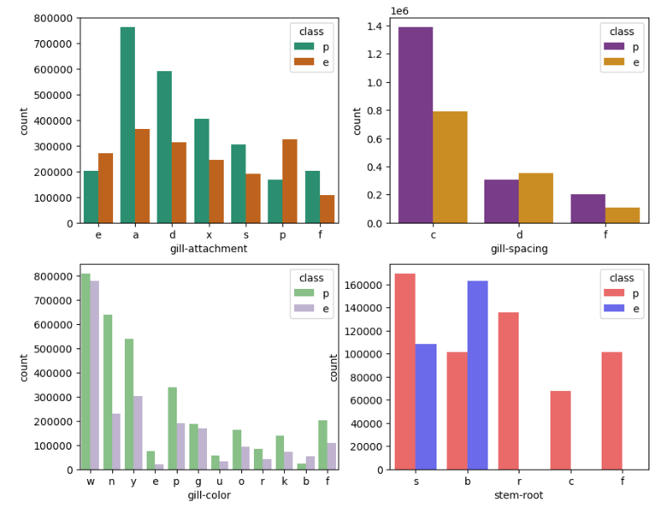
BIVARIATE ANALYSIS
Adnate gill attached are most frequently occurred one, hence which might be poisons,decurrent are poisonous mushroom
Most frequent mushrooms are close gill-spaced ,where the close gill-spacing mushroom might be poisonous
More frequently occurred white gill colored,brown,yellow,red,pink,black which might be poisonous
The rhixomorphs,rooted,cup shaped roots are completely poisonous,
the bulbous are edible mushrooms.

Slide 8
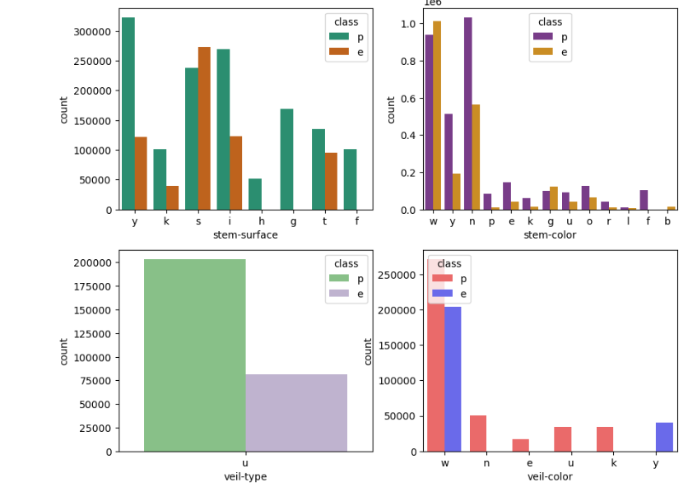
BIVARIATE ANALYSIS
The stem surfaces like shiny,grooves,sticky, are completely poisonous, smooth surfaced, sticky classes are pretty close.
Where black stem mushroom are completely edible.
From this graph, the veil typed mushrooms are universal shaped, which is not equally distributed, which might be poisonous
The yellow veil colored mushroom are completely edible, where white veil colored mushroom which are pretty close in both classes, where other classes are completely poisonous.

Slide 9
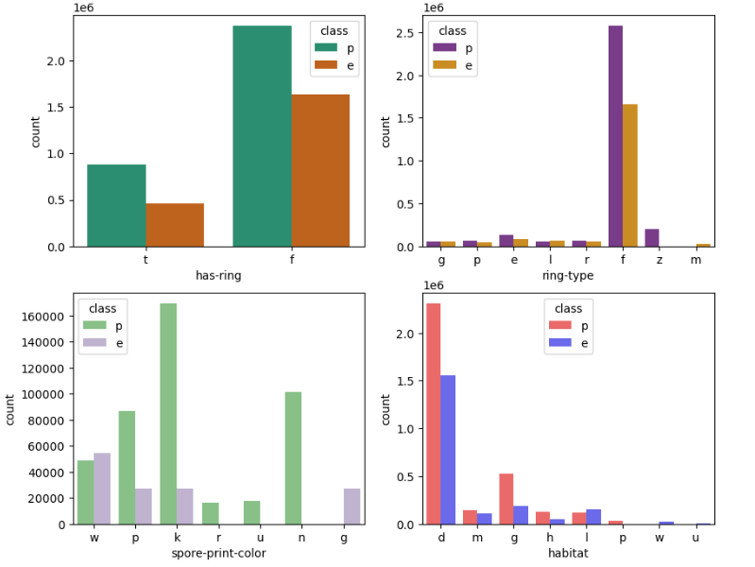
BIVARIATE ANALYSIS
Both ring shapes and non ring shaped mushrooms are pretty close in both the class
Zone ring type mushrooms are completely poisonous, where movable type is completely edible, where other types are close in both classes.
Gray spore-print color mushroom are completely edible, where green,purple,brown are completely poisons.
The mushrooms which are grow in waste,urban are edible type,where grown in paths are poisones.

Slide 10
MODELLING APPROACH USED
Logistic Regression:
Logistic regression ML model is a classification algorithm. In classification the target variable is categorical. It has different categories also known as classes.
The important part of logistic regression is that it works ideally when there are only two classes in the output variable.
Random Forest Classifier:
As a forest is made of trees similarly random forest is also made of decision trees, decision tree searches for the best feature while splitting a node random forest searches for the best feature among a random subset of a feature this will result in high diversity and gives better results. It is a form of supervised learning model.

Slide 11
RECOMMENDATIONS
From models Random forest being the best model, the feature importance of variables were calculated.
The goal is to create a reliable tool for differentiating between mushroom types, ensuring the safety of individuals engaging in mushroom foraging or related activities is very important.

Slide 12
THANK YOU

